Slide 1
Objectives
  In this lesson, you will learn to:
    Identify stateful session beans
    Create stateful session beans
    Implement stateful session beans

Slide 2
Pre-assessment Questions
  Invoking the remove() method to remove instances of session bean will throw the _____________ exception.
    EJBException
    CreateException
    RemoteException
    RemoveException
  Which method of the EJBHome interface is invoked by the clients to manage a stateless session bean remotely?
    getEJBHome()
    getHomeHandle()
    getHandle()
    isIdentical()

Slide 3
Pre-assessment Questions (Contd.)
  What is the number of arguments passed to the create()method to create a stateless session bean instance?
    One
    Two
    Three
    Zero
  Which method of the PortableRemoteObject interface is used by the clients to retrieve the reference of a stateless session bean home interface?
    getHomeHandle()
    getEJBMetaData()
    narrow()
    getEJBHome()

Slide 4
Pre-assessment Questions (Contd.)
  Which method is used by the setSessionContext() method defined in the SessionContext interface to get the the local interface of a session bean?
    getEJBHome()
    getEJBLocalObject()
    getEJBObject()
    getEJBLocalHome()

Slide 5
Solutions to Pre-assessment Questions
  a. EJBException
  b. getHomeHandle()
  c. Zero
  c. narrow()
  b. getEJBLocalObject()

Slide 6
Overview Of Stateful Session Beans
    In an application, a stateful session bean maintains the state of a client.
    A client starts a conversation with a stateful session bean when it invokes the bean’s method in an EJB object.
    When the conversation ends, the conversational state is preserved and client-specific information regarding the conversation between the client and the bean is stored.
    When the client calls another method in the stateful session bean, the client may require to know the conversational state of the previous method call. A stateful session bean retains conversational state for individual clients across method calls.

Slide 7
Overview Of Stateful Session Beans
  Life Cycle of Stateful Session Beans
    EJB container:
      Controls the life cycle of a stateful session bean.
      Assigns one stateful session bean instance to serve a single client at a time. As a result, there should be as many stateful session bean instances in the pool as the number of clients.
      Cannot randomly destroy a stateful session bean instance because it stores the client state.
      Ensures that the client state stored in the instance variables of a bean is not required in processing the application, before destroying a stateful session bean instance,.

Slide 8
Overview Of Stateful Session Beans
(Contd.)
    The stages in the life cycle of a stateful session bean are:
      Ready: In this stage, a stateful session bean instance remains in the shared pool and services client requests.
      Passive: In this stage, a stateful session bean instance stores client state in secondary storage and stops servicing client requests.
      Does Not Exist: In this stage, a stateful session bean is permanently removed from the shared pool.

Slide 9
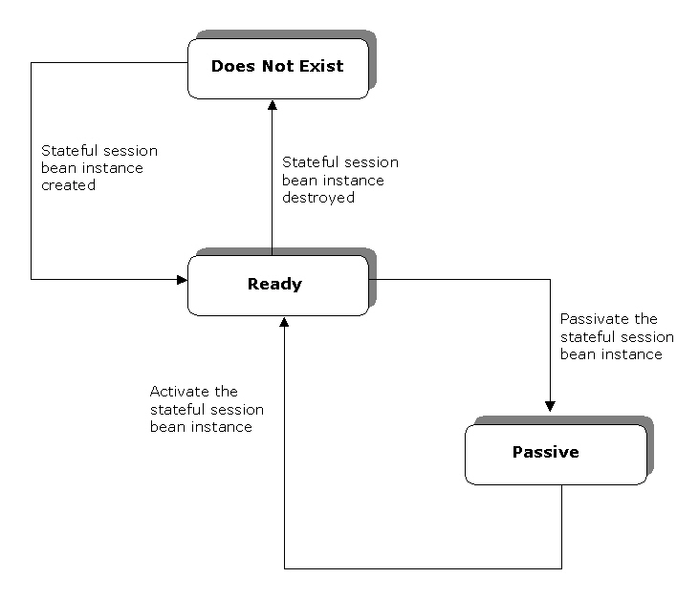
Overview Of Stateful Session Beans
(Contd.)
    The life cycle stages of a stateful session bean

Slide 10
Overview Of Stateful Session Beans
(Contd.)
    The Ready Stage
      At the beginning of its life cycle, a stateful session bean is in the Ready stage.
      A stateful session bean instance moves to the Ready stage in the following cases:
        When EJB container creates a new stateful session bean instance.
        When EJB container activates a passivated stateful session bean.
      EJB container creates new stateful session bean instances when there are insufficient stateful session bean instances in the shared pool to service client requests.

Slide 11
Overview Of Stateful Session Beans
(Contd.)
    To create a new stateful session bean instance, EJB container performs the following steps:
      EJB container invokes the:
        newInstance() method, which instantiates a new stateful session bean instance.
        setEntityContext() method to associate the stateful session bean instance with the bean context.
        ejbCreate() method of the stateful session bean class. You can pass arguments to the ejbCreate() method to initialize a new stateful session bean instance. A stateful session bean can have more than one ejbCreate() method, where each method has a different number and type of arguments.

Slide 12
Overview Of Stateful Session Beans
(Contd.)
      A stateful session bean instance can also reach the Ready stage, when EJB container activates a passivated stateful session bean by invoking the ejbActivate() method.
      The ejbActivate() method transfers a passivated stateful session bean’s client state to the stateful session bean instance variables.
      EJB container calls the ejbActivate() method to allow the bean to acquire the resources released by it during passivation.

Slide 13
Overview Of Stateful Session Beans
(Contd.)
    The Passive Stage
      A stateful session bean moves to the Passive stage in its life cycle when EJB container releases it from serving an idle client and returns the stateful session bean instance to the shared pool to service another client’s requests.
      Before passivation, EJB container saves the client state associated with the stateful session bean instance in a secondary storage device, such as hard disk in the server.
      EJB container calls the ejbPassivate() method before it passivates a session bean. This allows a stateful session bean to release its resources.

Slide 14
Overview Of Stateful Session Beans
(Contd.)
    The Does Not Exist Stage
      At the end of its life cycle, a stateful session bean instance moves to the Does Not Exist stage.
      A stateful session bean instance reaches this stage in the following cases:
        When EJB container invokes the ejbRemove() method.
        When the timeout of the bean instance lifecycle, specified by the bean developer, expires.

Slide 15
Overview Of Stateful Session Beans
(Contd.)
      EJB container destroys stateful session bean instances when the number of instances is greater than the number of active client requests.
      EJB container fails to invoke the ejbRemove() method in the following cases:
        When EJB container failure occurs.
        When a stateful session bean method execution throws a system exception.

Slide 16
Overview Of Stateful Session Beans
(Contd.)
  Activation and Passivation of Stateful Session Beans
    EJB container passivates and activates the stateful session bean instances in the shared pool to reduce the overhead of storing a large number of bean instances.
    EJB container stores the bean state of an idle bean instance in a secondary storage device. This process is called passivation.
    When the client of a passivated bean calls another bean method, the bean state is restored to a stateful session bean instance. This process is called activation.

Slide 17
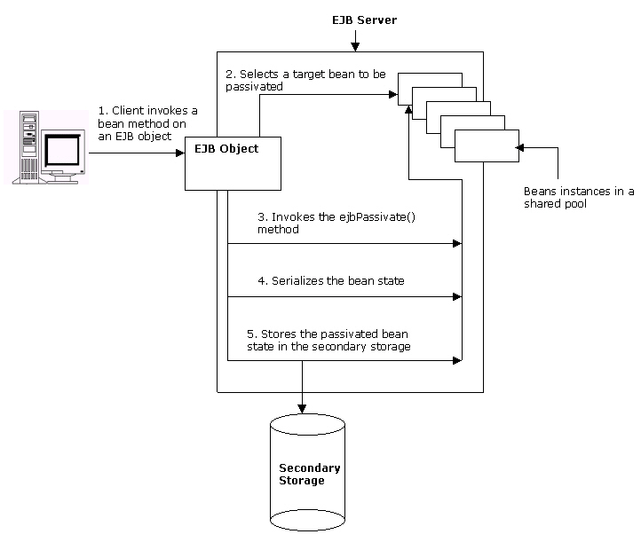
Overview Of Stateful Session Beans
(Contd.)
    The passivation of stateful session bean

Slide 18
Overview Of Stateful Session Beans
(Contd.)
    Stateful session beans preserve the references of the following interfaces, in addition to client-specific information during passivation:
      javax.ejb.EJBHome
      javax.ejb.EJBObject
      javax.jta.UserTransaction
      javax.naming.Context
      javax.ejb.EJBLocalHome
      javax.ejb.EJBLocalObject

Slide 19
Overview Of Stateful Session Beans
(Contd.)
    Various algorithms used to implement passivation are:
      Least Recently Used (LRU): Selects the stateful session bean instance which has been inactive for the longest duration. This is also known as eager passivation.
      Not Recently Used (NRU): Selects the stateful session bean instance which has become inactive recently.
      First In First Out (FIFO): Selects the stateful session bean instance which had entered the pool first and is inactive. This is also known as lazy passivation.
    Most EJB servers use just-in-time algorithm, according to this algorithm, a passivated bean is activated when a client request regarding this bean is made.

Slide 20
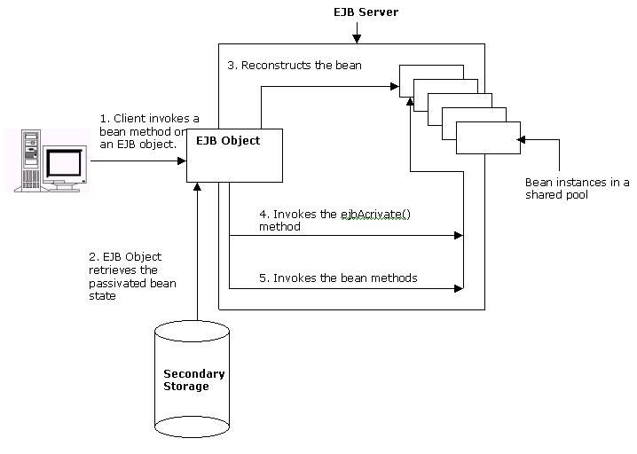
Overview Of Stateful Session Beans
(Contd.)
    The activation of a stateful session bean

Slide 21
Creating Stateful Session Beans
    You need to develop the bean interfaces and the bean class to create a stateful session bean.
    After creating the files, you need to compile them to generate the class files.
    You package the compiled files in a single Java Archive (JAR) file. This JAR file is then packaged to a J2EE application EAR file and deployed on the J2EE Application Server.
    After you deploy the stateful session bean, you can access it using Web or Application clients.

Slide 22
Creating Stateful Session Beans (Contd.)
  Using Java Files to Create a Stateful Session Bean
    You need to define three Java class files in order to create a stateful session bean.
      Stateful session bean home interface: Defines methods to create and remove stateful session bean instances.
      Stateful session bean remote interface: Defines business methods that clients can call. These methods are implemented in the stateful session bean class.
      Stateful session bean class: Implements stateful session bean life cycle methods and the business methods declared in the stateful session bean remote interface.

Slide 23
Creating Stateful Session Beans (Contd.)
    Creating the Stateful Session Bean Home Interface
      Clients use an implementation of the stateful session bean home interface to create a stateful session bean instance.
      The stateful session bean home interface extends the javax.ejb.EJBHome interface.
      Clients use the methods defined in the javax.ejb.EJBHome interface to manage a stateful session bean instance.
      The stateful session bean home interface defines the create() method to create new stateful session bean instances.

Slide 24
Creating Stateful Session Beans (Contd.)
      There can be multiple create() methods in the stateful session bean home interface but the signature of each create() method should be different.
      The return type of the create() method is a reference to the implementation of stateful session bean remote interface.
      In the stateful session bean home interface, the throws clause of the create() method includes the exceptions, javax.ejb.CreateException and javax.ejb.RemoteException.

Slide 25
Creating Stateful Session Beans (Contd.)
      Creating the Stateful Session Bean Remote Interface
        Remote clients access stateful session bean business methods using the methods defined in the stateful session bean remote interface.
        The stateful session bean remote interface extends the javax.ejb.EJBObject interface.
        The stateful session bean remote interface defines the business methods implemented in the stateful session bean class.
        The signature of the business methods should be the same as the business methods implemented in the stateful session bean class.
        All business methods should throw the javax.ejb.RemoteException exception.

Slide 26
Creating Stateful Session Beans (Contd.)
      Creating a Stateful Session Bean Class
        The stateful session bean class implements the life cycle and the business methods of the stateful session bean application.
        The stateful session bean class implements the javax.ejb.SessionBean interface, which defines the methods that EJB container invokes to manage the life cycle of a stateful session bean instance.
        A stateful session bean class declares instance variables to save the client state. A stateful session bean class is declared as public.

Slide 27
Creating Stateful Session Beans (Contd.)
  Compiling and Deploying a Stateful Session Bean
    After creating the Java files for a stateful session bean, compile all the Java files using the javac compiler.
    Command used to compile the Java files is javac <file_name>.
    The compiled Java class files of the stateful session bean application are deployed in the J2EE1.4 Application Server using the deploytool utility.
    The New Enterprise Bean Wizard of the deploytool utility deploys a stateful session bean.
    The deploytool utility packages the compiled Java class files in a JAR file before deploying the bean.
    The deploytool utility automatically generates the deployment descriptor of the stateful session bean.

Slide 28
Creating Stateful Session Beans (Contd.)
  Accessing a Stateful Session Bean
    A client accesses a stateful session bean’s business methods using the references of its home and remote interfaces.
    Both, Web clients and Application clients, can access a stateful session bean. A client performs the following steps to access a stateful session bean:
      Locates a stateful session bean deployed in the J2EE 1.4 Application Server.
      Retrieves references of the stateful session bean home and remote interfaces.

Slide 29
Creating Stateful Session Beans (Contd.)
    Locating a Stateful Session Bean
      A client locates a stateful session bean in the J2EE 1.4 Application Server using Java Naming Directory Interface (JNDI).
      To locate a stateful session bean, a client should:
        Create an initial naming context by using the InitialContext interface of JNDI.
        Locate the deployed stateful session bean after creating an initial context by using the lookup() method. The lookup() method returns the reference of the stateful session bean home interface.

Slide 30
Creating Stateful Session Beans (Contd.)
    Retrieving References of Stateful Session Bean Interfaces
      A client:
        Should retrieve references to the stateful session bean home and remote interfaces after locating the stateful session bean.
        Can use the reference of the stateful session bean remote interface to invoke a bean’s business methods.
        Uses the narrow() method of the PortableRemoteObject interface to retrieve the reference to a stateful session bean home interface.

Slide 31
Creating Stateful Session Beans (Contd.)
    A local client should use the lookup() method of the InitialContext interface to retrieve a reference to stateful session bean local home interface.
    A client retrieves a reference to the remote or local interface of the stateful session bean by calling the create() method in the stateful session bean home interface.

Slide 32
Creating Stateful Session Beans (Contd.)
  Responsibilities of the Session Bean Provider and the EJB Container Provider are:
    The responsibilities of the session bean provider are:
      Creating the stateful session bean remote home interface.
      Creating the stateful session bean remote local interface.
      Creating the stateful session bean remote interface.
      Creating the stateful session bean class.
      Closing all database connections in the stateful session bean ejbPassivate() method and assigning null values to the connection instance variables.

Slide 33
Creating Stateful Session Beans (Contd.)
      The responsibilities of the EJB container provider are:
        Providing the deployment tool to deploy session beans.
        Managing the life cycle of a session bean instance.
        Ensuring that a session bean instance services only one client request at a time. EJB container throws the javax.ejb.RemoteException or the javax.ejb.EJBException when a client tries to access a session bean instance that is already servicing another client’s request.
        Handling run-time exceptions thrown by session bean instances.

Slide 34
Creating Stateful Session Beans (Contd.)
        Implementing the SessionContext.getEJBObject() method to retrieve a reference to the session bean remote interface.
        Serializing the client state of a stateful session bean instance after invoking the ejbPassivate() method.
        Removing a stateful session bean instance if the bean instance does not adhere to the serialization requirements.
        Saving and restoring the client state during stateful session bean instance passivation and activation.

Slide 35
Demonstration - Implementing Stateful Session Beans
  Problem Statement
    Richard is developing an online university registration application. Using this application, students can browse and register for the courses offered by the university. A student can register for more than one course at a time. The application facilitates users to first select the courses and store them in a course cart. Later the students can register for them together. Richard decides to develop the course cart using a stateful session bean.

Slide 36
Demonstration - Implementing Stateful Session Beans (Contd.)
  Solution
    To solve the above problem, perform the following tasks:
      Create the stateful session bean home interface.
      Create the stateful session bean remote interface.
      Create the stateful session bean class.
      Create the Web client.
      Package the stateful session bean.
      Package the Web client.
      Specify the Web client’s enterprise bean reference.
      Deploy the application.
      Test the application.

Slide 37
Summary
In this lesson, you learned:
  A stateful session bean preserves client state across method invocation and transaction.
  A stateful session bean life cycle consists of three stages, Ready, Passive, and Does Not Exist.
  EJB container invokes the ejbCreate() method to initialize a new stateful session bean instance.
  EJB container passivates and activates stateful session bean instances to reduce the overhead of maintaining large number of bean instances in the shared pool.
  EJB container uses LRU, NRU, and FIFO algorithms to select the stateful session bean instance to be passivated.
  The just-in-time algorithm is used to activate a passivated stateful session bean.

Slide 38
Summary (Contd.)
  To create a stateful session bean for remote clients, you need to create the following Java files:
    Stateful session bean home interface
    Stateful session bean remote interface
    Stateful session bean class
  The home interface of a stateful session bean extends the javax.ejb.EJBHome interface.
  The create() method of a stateful session bean home interface is used to obtain a reference to the an object that implements the remote interface of the bean.
  The remote interface of a stateful session bean extends the javax.ejb.EJBObject interface .

Slide 39
Summary (Contd.)
  The bean class of a stateful session bean implements the javax.ejb.SessionBean interface.
  A client uses JNDI to locate a deployed stateful session bean.

